Slide 1
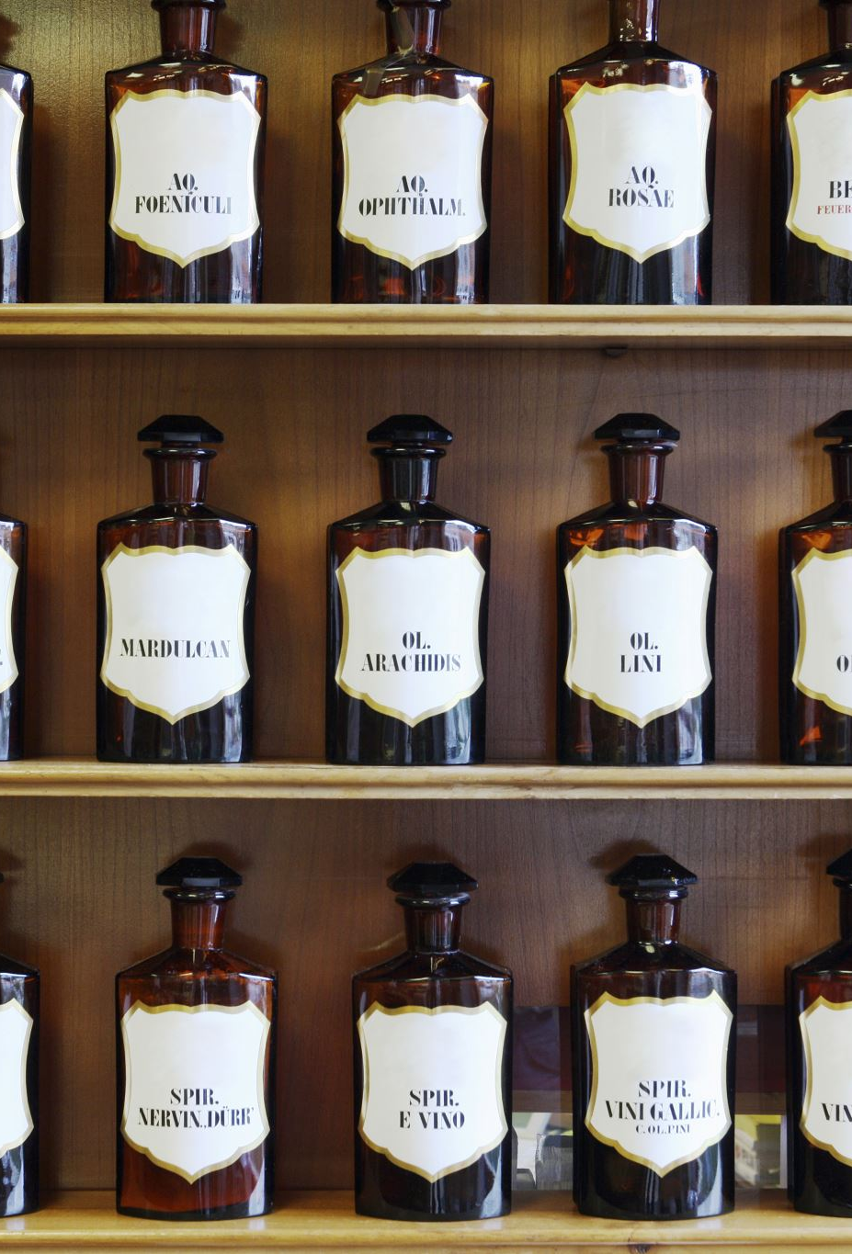
DATA602: PROJECT PRESENTATION TOPIC: ANALYZE AND FORECAST IOWA LIQUOR SALES
PROJECT TEAM:
AKHILTEJA JAMPANI(ID: CK38174)
SOHAIL SHAIK(ID: TH04570)

Slide 2
Context:
Introduction to the problem statement
Business objectives
About the data set
Proposed solution
Data preparation & Modelling
Challenges
Conclusion

Slide 3
Introduction to the problem statement
Iowa is an alcohol beverage control state, which means that the state has a monopoly on the wholesale distribution of alcohol throughout the state. Private retailers must buy alcohol from the state before selling it to individual customers. The state regulates the traffic of alcoholic beverages to protect the welfare, health, peace, morals, and safety of the state's citizens. Furthermore, since 2012, the state has provided monthly E license liquor sales data containing over 24 million transaction records.

Slide 4
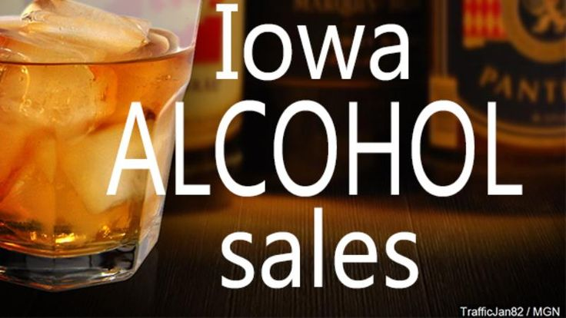

Slide 5
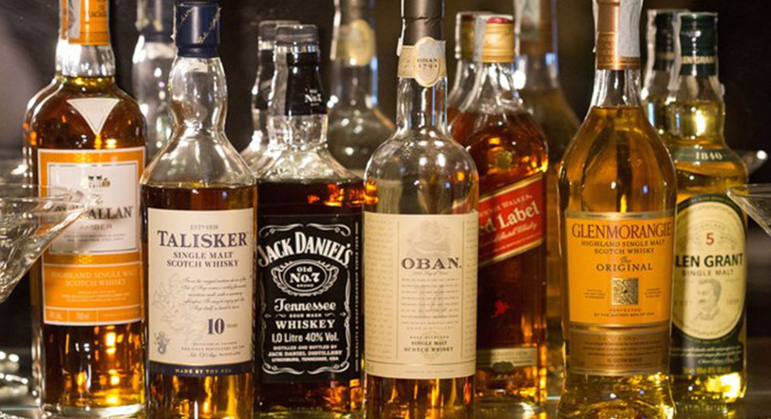
Now, the Iowa state government wants to analyze its past data to reward its purchasers.
Also, to forecast future outcomes.
In the following slide, we will discuss some of the analysis points and predictions in the form of business objectives.

Slide 6
Business objectives:
Analyzing the past data :
Examine and analyze the entire Iowa liquor sales data set.
Find the best liquor category by volume sold, Sales (dollars), and profit (dollars)
Find the monthly best vendor based on volume purchased, Sales (dollars), and profit(dollars). Iowa government can give some monthly rewards to its best vendors.
Perform a time series analysis between essential features to identify the pattern.

Slide 7
Business objectives:
Future forecast :
Build a model to predict the liquor volume sold by the Iowa government.
Build a model to forecast liquor sales (in dollars) from the Iowa government.
Build a model to predict profit (in dollars) or profit percentage by liquor of sale.
Compare regression models and select the best model that fits the Iowa liquor dataset.
Displaying the model’s output and its results.

Slide 8
About THE Data set:
The data is taken from Iowa’s state-hosted open-source data portal. This portal contains over 24 million transactions, of which we are considering the last six months’ data from 1st April 2022 to 1st October 2022, with 1.3 million transaction records.
URL: data.iowa.gov
This data set contains 24 features

Slide 9
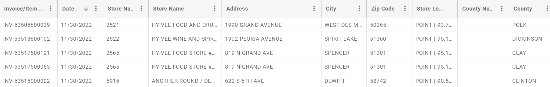
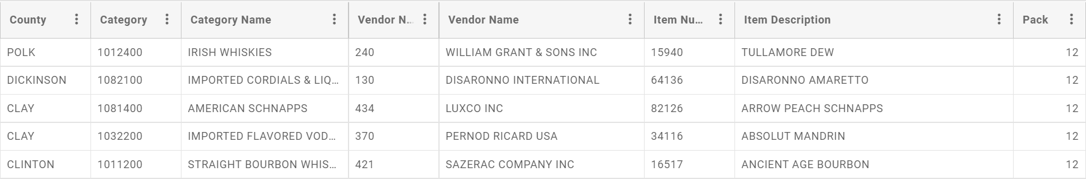
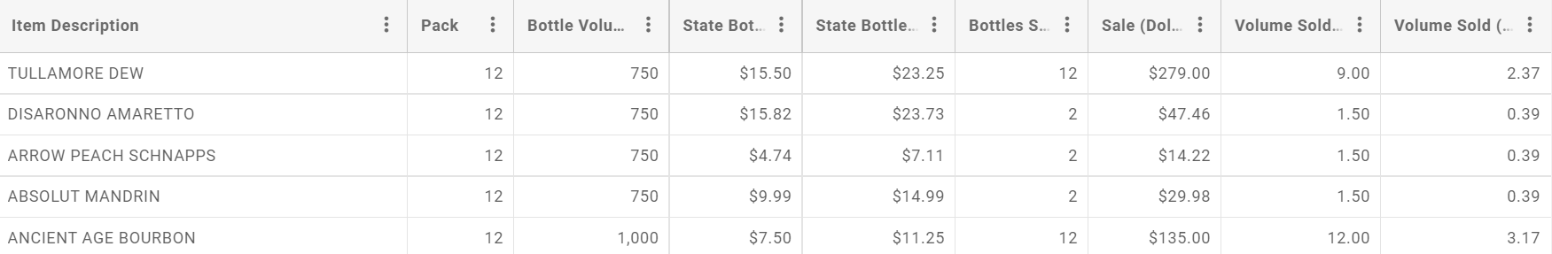

Slide 10
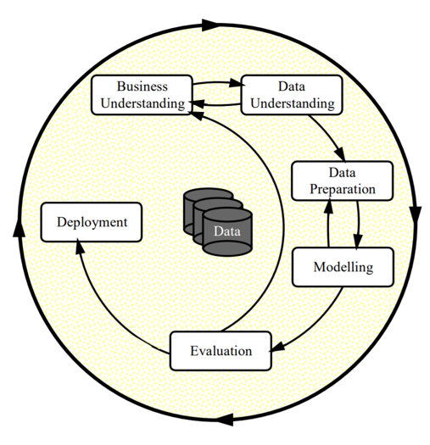
Proposed solution:
In this project, we are following the standard CRISP-DM process.
We have seen business objectives and data understanding.

Slide 11
data preparation :
Data fetching
Data cleaning
Feature selection
Data transformation
Feature engineering
Dimensionality reduction

Slide 12
MODELLING
The regression modeling technique from supervised learning is used in all three models. This project employs a variety of regression techniques.
Linear regression
Polynomial regression
LASSO regression
Ridge regression
Elastic Net regression

Slide 13
MODELLING
In addition to regression models, some popular classification models can be used to solve regression model problems.
Decision Trees Regressor
Random Forests Regressor
Xgboost Regressor

Slide 14
Challenges:
Data is not labeled correctly; it might require much cleaning and transformation.
Considering the last six months’ data, it is over 1.3 million rows. Finding hyperparameters and running the model might take a longer time to execute.

Slide 15
Conclusion
The Iowa government will have solutions to all of its objectives by the end of the project.
They can identify the best liquor category at the end of each month and reward the best vendors based on total volume purchased, total scales (dollars), and total profit (dollars).
The government can also predict future outcomes of liquor sales (in dollars), liquor volume sold, and profit (in dollars).

Slide 16

Thank you…

